Slide 1
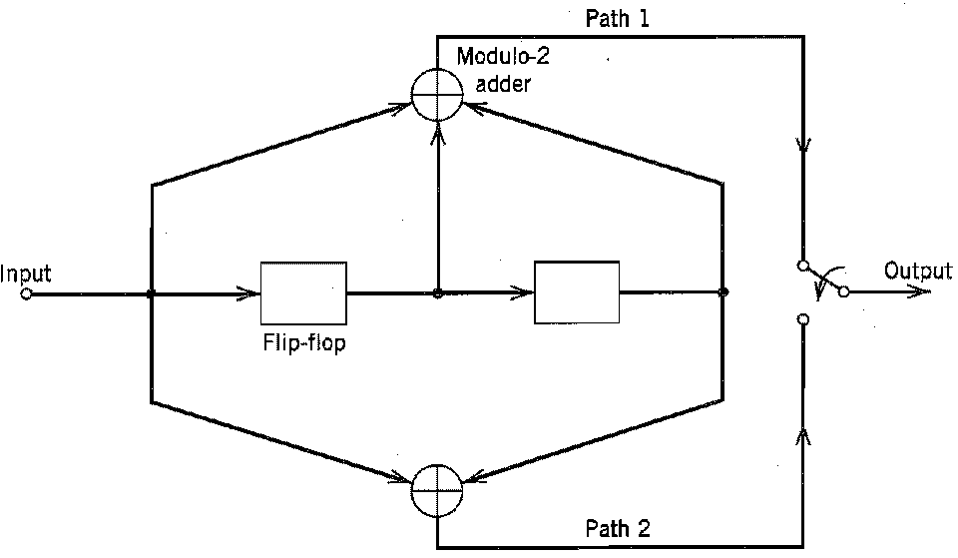
Structural Properties of Convolutional Code
▶ The structural properties of a convolutional encoder are portrayed by using any one of three equivalent graphs: code tree, trellis graph, and state graph.

Slide 2
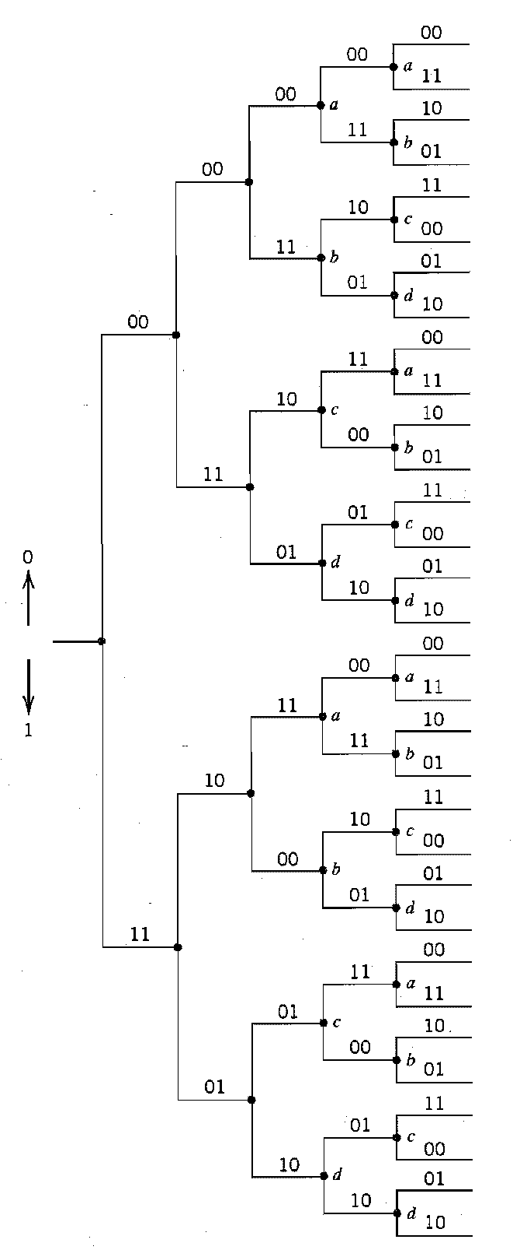
Code Tree

Slide 3
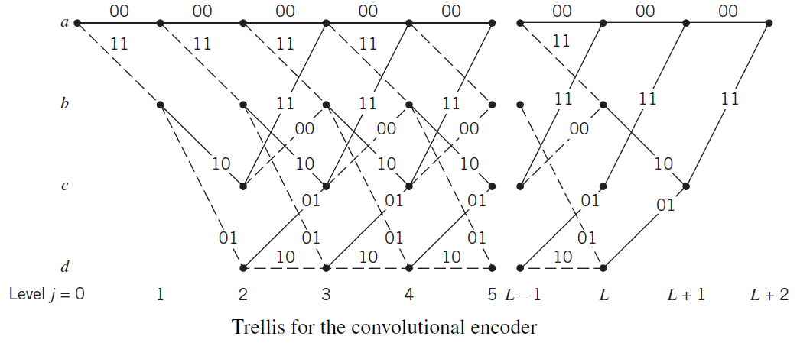
Trellis Graph
▶ A code branch in a trellis produced by input bit 0 is drawn as a solid line, whereas a code branch produced by input bit 1 is a dashed line.

Slide 4
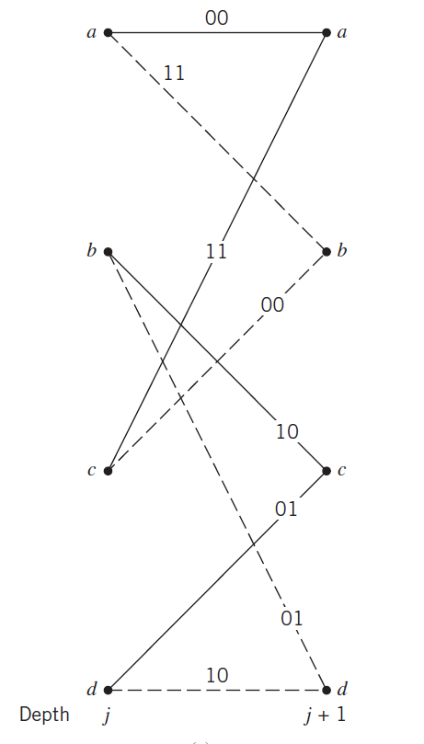
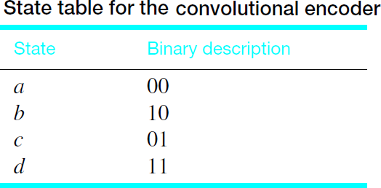

Slide 5
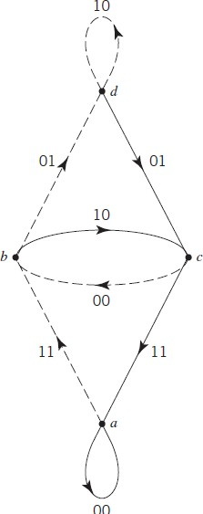
State Diagram

Slide 6
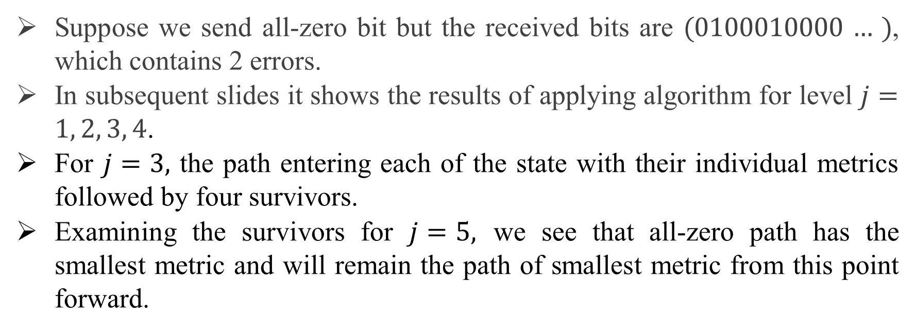
Decoding of Convolutional Codes-Viterbi Algorithm
Suppose we send all-zero bit but the received bits are (0100010000 … ), which contains 2 errors.
In subsequent slides it shows the results of applying algorithm for level $j=1, 2, 3, 4$.
For $j=3,$ the path entering each of the state with their individual metrics followed by four survivors.
Examining the survivors for $j=5,$ we see that all-zero path has the smallest metric and will remain the path of smallest metric from this point forward.

Slide 7
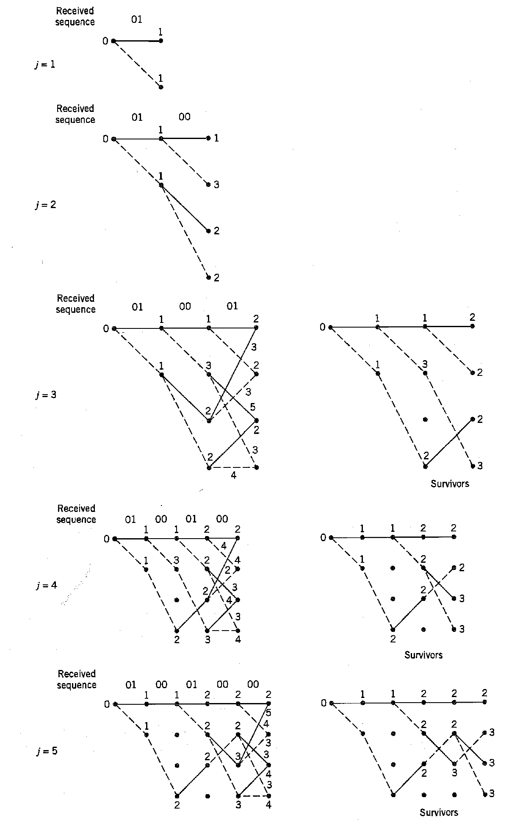
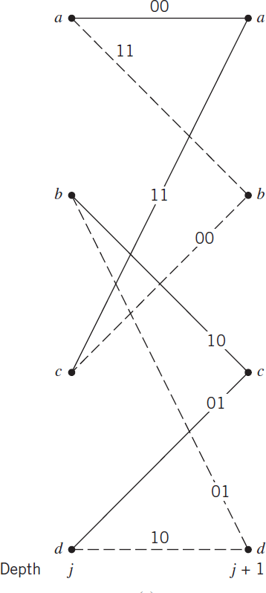

Slide 10
Incorrect decoding of received sequence
▶ Length of error pattern spread over a time span shorter than one constraint length of the encoder is uncorrectable by the Viterbi algorithm.
▶ Suppose we send all-zero bit but the received bits are (1100010000 … ), which contains three errors. There are 3 errors in the received sequence

